Slide 1

Ad-Hoc Insights consumer goods
Curated by PRANJAL SHARMA

Slide 2
Objectives
Atliq Hardware (fictitious corporation), a leading computer hardware manufacturer in India with a significant global presence, recognizes the need for better insights to support timely, informed decision-making.
To address this, they plan to grow their data analytics team by hiring junior data analysts.
The data analytics director intends to use an SQL challenge as part of the candidate assessment process, evaluating both technical and soft skills.
The company is looking to gain insights from ten specific ad hoc requests.

Slide 3
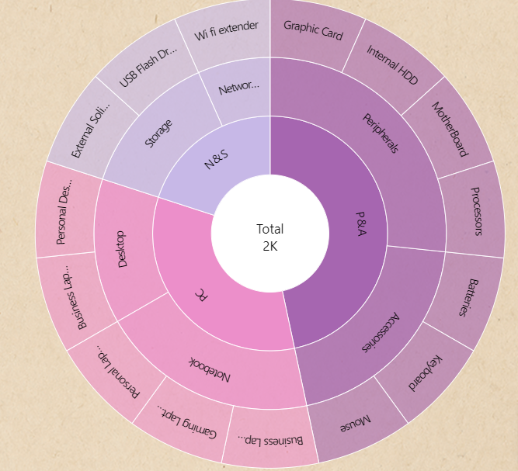
Company details
Atliq Hardware is a computer hardware and accessory manufacturer.
Outer Circle : Category
Fiscal Year
September 2019 – August 2020
FY 2020
September 2020 – August 2021
FY 2021
Mid Circle : Segment
Inner Circle : Division

Slide 4
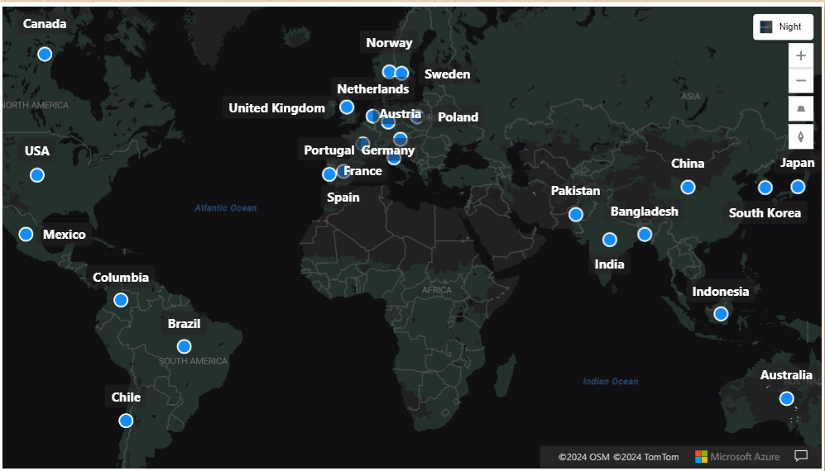
Company’s market
Atliq Hardware

Slide 5
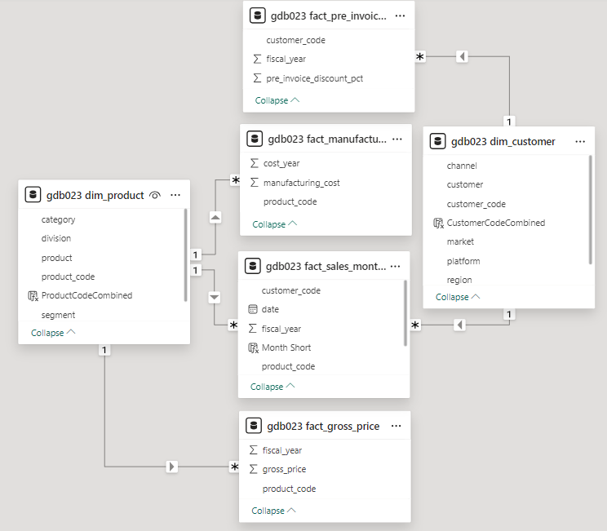
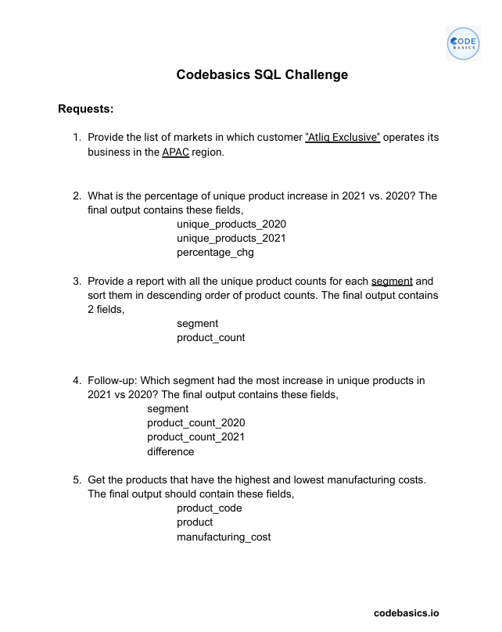
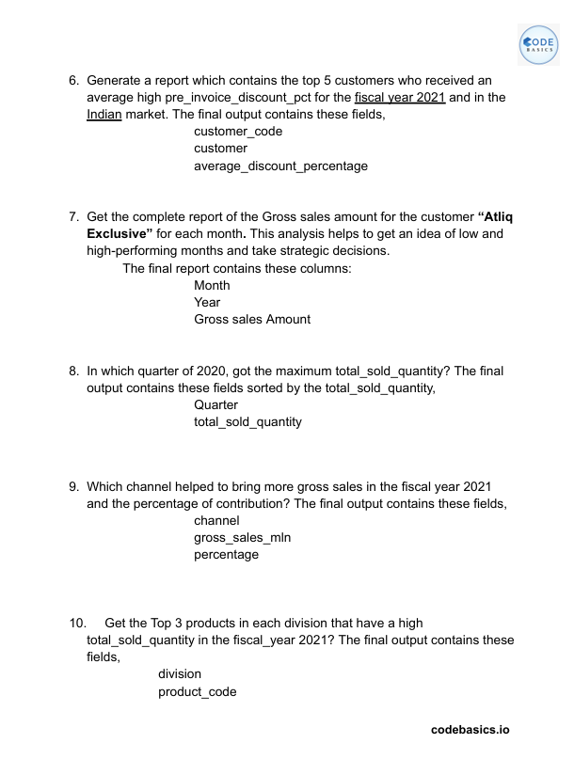
Data, requests, and tools

Slide 6
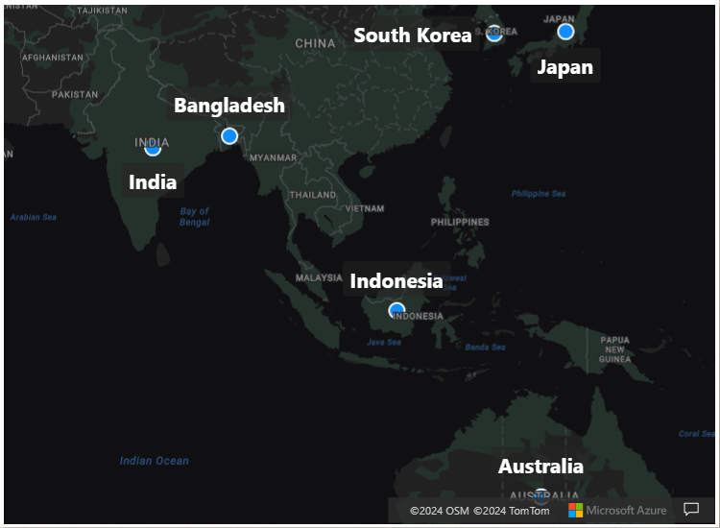

1. Provide the list of markets in which customer "Atliq Exclusive" operates its business in the APAC region.

Slide 7
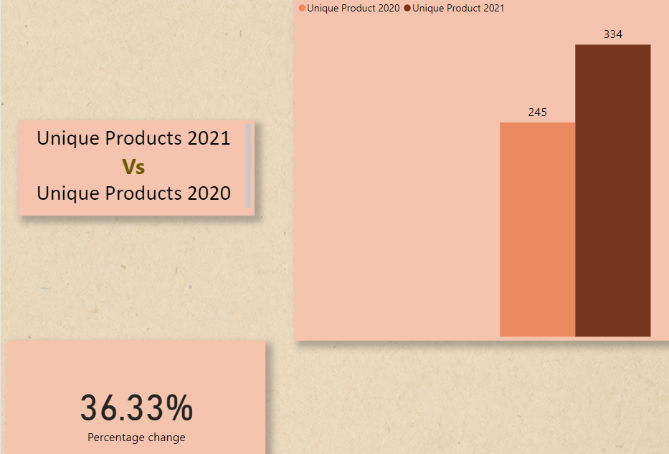
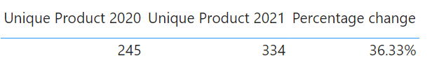
2. What is the percentage of unique product increase in 2021 vs. 2020? The final output contains these fields, unique_products_2020, unique_products_2021, percentage_chg
Insight : Demand and production both increased

Slide 8
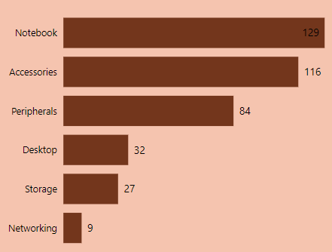
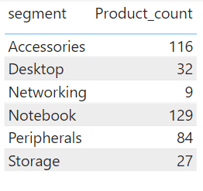
3. Provide a report with all the unique product counts for each segment and sort them in descending order of product counts. The final output contains 2 fields, segment, product_count
Worrisome
Insight : The manufacturing growth of segments such as notebooks, accessories, and peripherals is notably higher compared to that of desktops, storage, and networking.
Notebooks, accessories, and peripherals make up 83% of the total manufactured products.

Slide 9
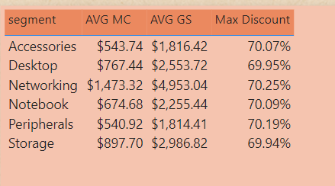
Wifi extender
USB Flash Drives
External Solid State Drives
Personal Desktop
Business Laptop
Suggestions :
Package Deal
Customer Services
Free Vouchers
Student Discount
Memberships
Gift cards
Cashback
AVG MC : Average Manufacturing Cost
AVG GS : Average Gross Sales

Slide 10
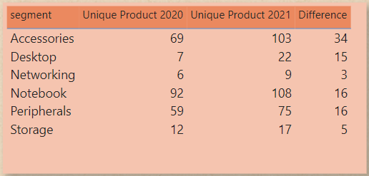
4. Follow-up: Which segment had the most increase in unique products in 2021 vs 2020? The final output contains these fields, segment, product_count_2020, product_count_2021, difference
Insight :
Accessories have seen the most significant rise in production.
The production growth of storage and networking segments is lagging behind that of other segments.

Slide 11
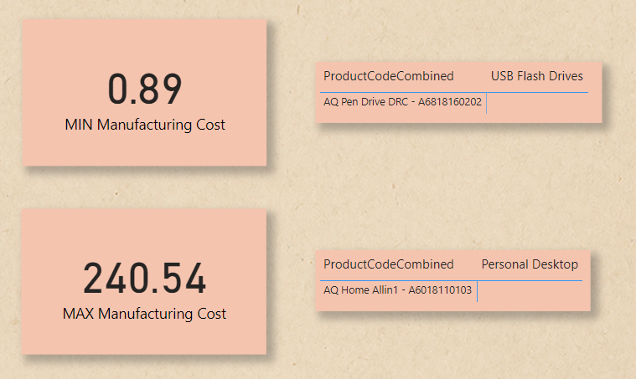
5. Get the products that have the highest and lowest manufacturing costs. The final output should contain these fields, product_code, product, manufacturing_cost
Insight :
AQ Pen Drive DRC has the lowest manufacturing cost.
AQ Home Allin1 has the highest manufacturing cost.

Slide 12
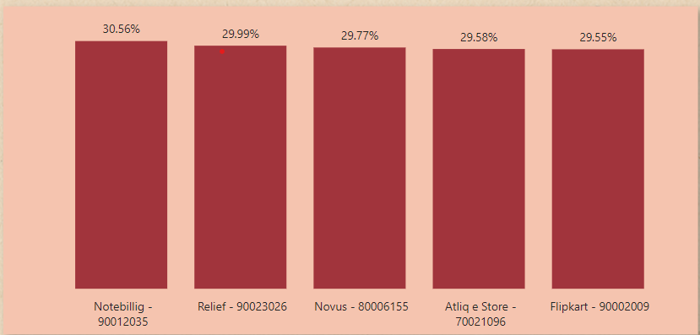
6. Generate a report which contains the top 5 customers who received an average high pre_invoice_discount_pct for the fiscal year 2021 and in the Indian market. The final output contains these fields, customer_code, customer, average_discount_percentage
Insight :
The largest average pre-invoice discount was given to Notebillig.
The least average pre-invoice discount was given to Flipkart.

Slide 13
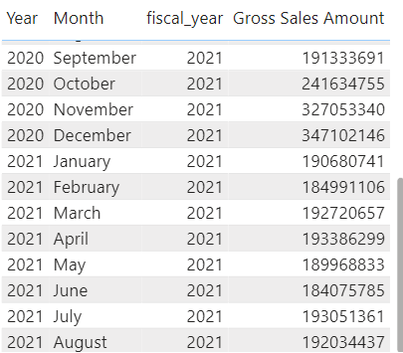
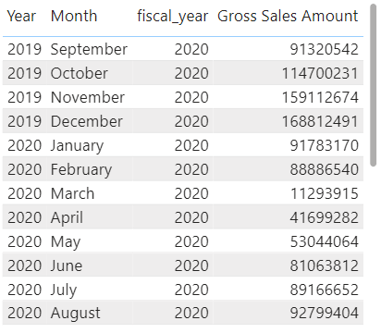
7. Get the complete report of the Gross sales amount for the customer “Atliq Exclusive” for each month . This analysis helps to get an idea of low and high-performing months and take strategic decisions. The final report contains these columns: Month, Year, Gross sales Amount
Insights :
The lowest gross sales total for both fiscal years is in March (2020).
The highest gross sales total for both fiscal years is in November (2020).
73.8% of the total gross sales figure is in FY 2021.
FY 2021
FY 2020

Slide 14
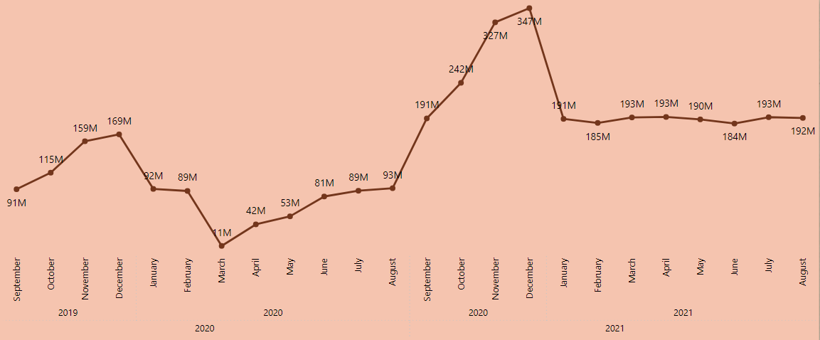
Highest Gross Sales
Lowest Gross Sales
Reasons :
COVID – 19
Global Chip shortage

Slide 15
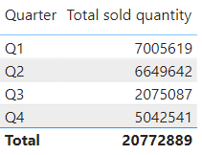
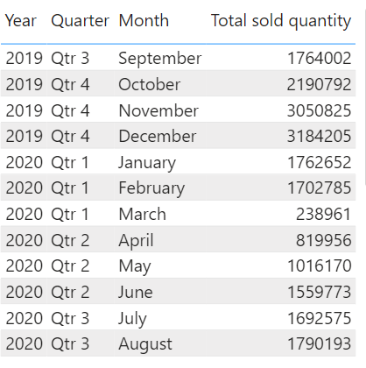
8. In which quarter of 2020, got the maximum total_sold_quantity? The final output contains these fields sorted by the total_sold_quantity, Quarter, total_sold_quantity
Insights :
Quarter 1 of FY 2020 saw the most units sold overall, while Quarter 3 had the fewest.
The highest and lowest overall sold quantity is in December and March.
Quarter 1 accounts for approximately 34% of the total sold quantity for FY 2020.

Slide 16
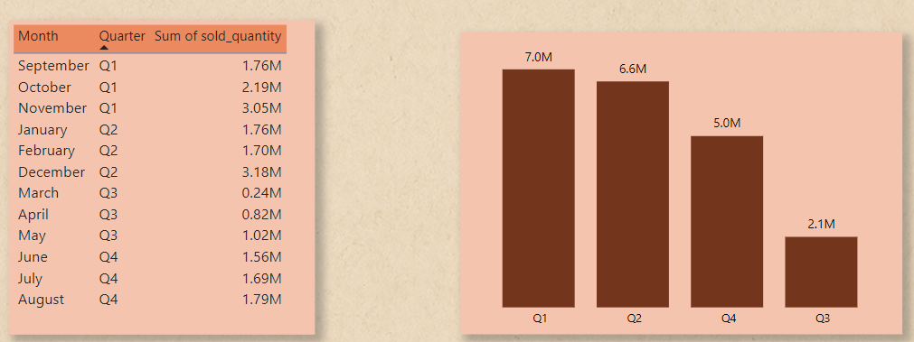
Total sold quantity in FY 2020 by Quarter

Slide 17
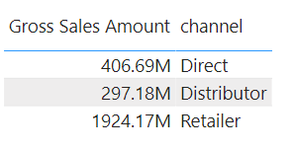
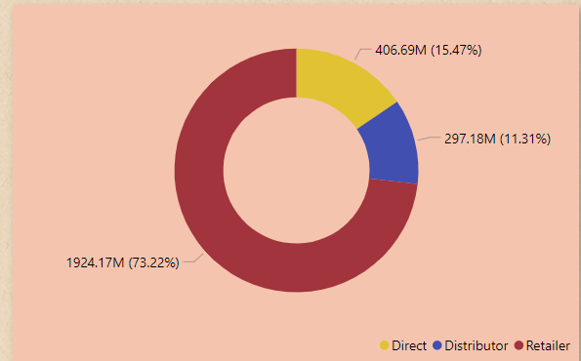
9. Which channel helped to bring more gross sales in the fiscal year 2021 and the percentage of contribution? The final output contains these fields, channel, gross_sales_mln, percentage
Insights :
Channel : “Retailer” helped bring maximum sales to the company with 73.22% as the contribution percentage.
Channel : “Distributor” makes the least contribution at a percentage of 11.31%.

Slide 18
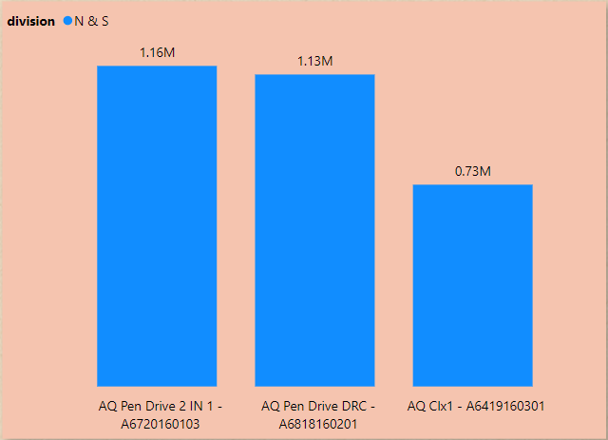
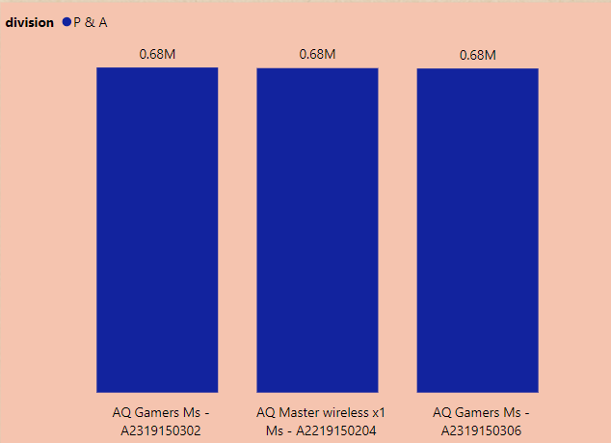
10. Get the Top 3 products in each division that have a high total_sold_quantity in the fiscal_year 2021? The final output contains these fields, division, product_code, product, rank_order, total_sold_quantity

Slide 19
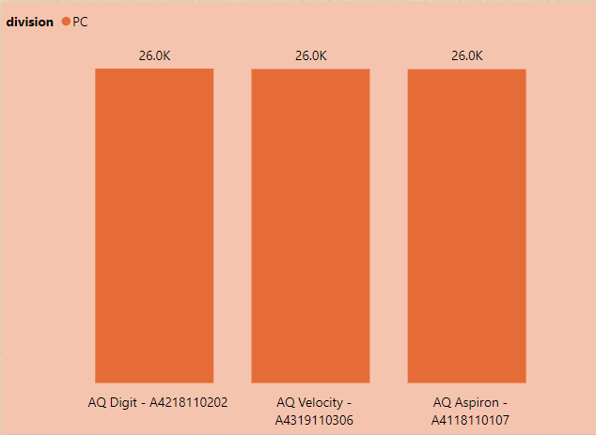
Insight : Every division has a product with different variants that appears twice in the top three products by division list.

Slide 20

THANK YOU

